Slide 1
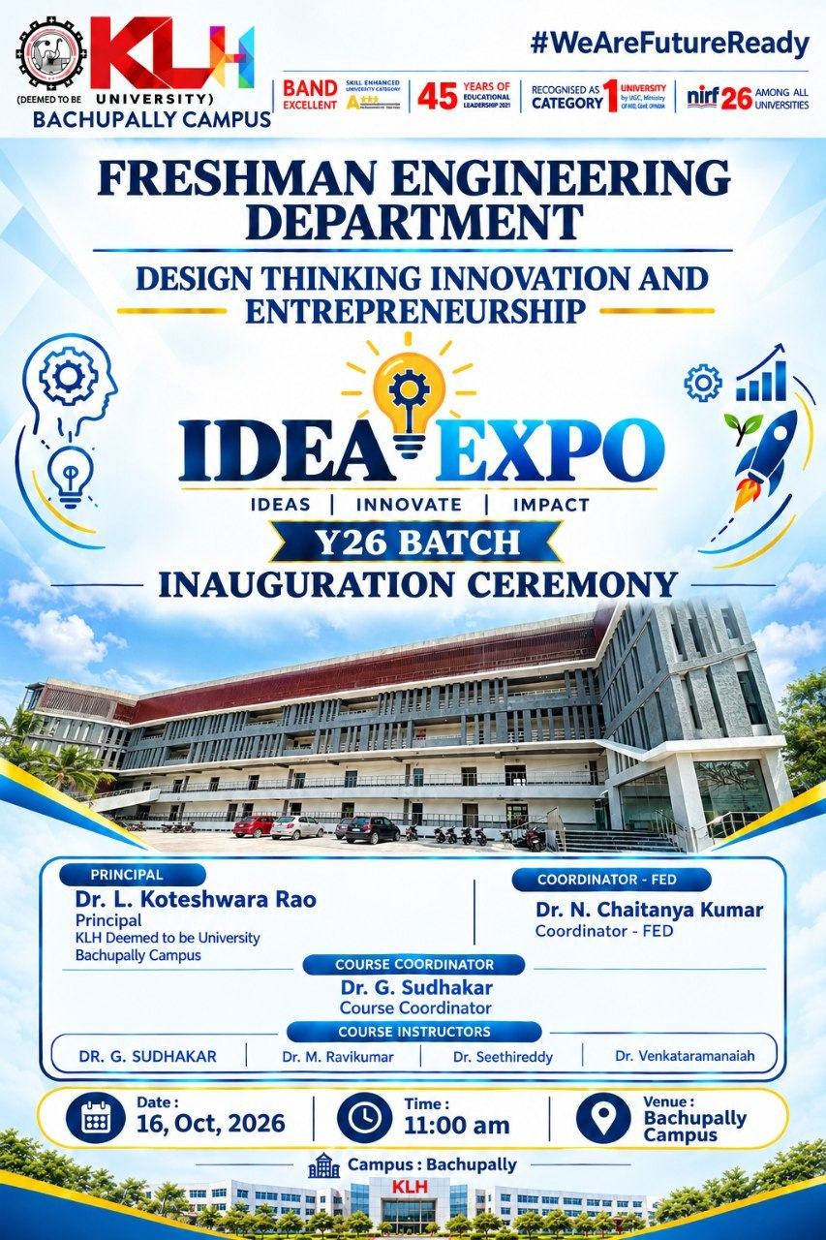

Slide 2
Disaster Preparedness and
Response Education System
DESIGN THINKING FOR INNOVATION & ENTREPRENEURSHIP (DTIE)
Greoup-6 | Section: 13
DisasterReady — Be Prepared. Stay Safe. Save Lives.
LEARN • PREPARE • RESPOND • RECOVER

Slide 3
Project Team
TEAM MEMBERS
PROJECT
1. I. Hema Sai Vaishnav-2620030303
2. N.Pranav-2620090017
3. V.Bhavya-2620030177
4. K. Madhavi-2620080102
5. M.Meghana Sruthi-2620030293
6. Abhinaya-2620030366
Disaster preparedness learning hub for schools, colleges and communities.
DESIGN APPROACH
Understand the problem → identify learner needs → design easy lessons → test with users → improve using feedback.
Institution: KLH Bachupally | DTIE Project

Slide 4
Vision and Mission
VISION
MISSION
Build a society where every student knows how to stay safe before, during and after a disaster.
Make disaster education simple, engaging and accessible through short lessons, safety checklists and practice activities.
Core promise: knowledge that can be used in real life.

Slide 5
Problem Statement
LOW AWARENESS
LIMITED PRACTICE
SCATTERED INFO
Many learners may not know the correct first steps during a flood, fire, earthquake or severe storm.
Safety information is often learned as theory, with fewer interactive practice opportunities.
Guidance can be spread across different sources and may be difficult to remember quickly.
Design challenge: How might we help students learn and practise disaster safety in one easy place?

Slide 6
Research, Facts and Market Study
WHAT GOOD GUIDANCE USES
LEARNING NEED
Clear emergency plans, training, drills and regular review help schools prepare.
Learners benefit from age-appropriate content, scenarios, teamwork and practice.
OUR RESEARCH METHOD
DESIGN OPPORTUNITY
Review existing preparedness resources and ask students/teachers what they find confusing.
Combine simple lessons, checklists, quizzes and local emergency contacts in one learning hub.
Reference: U.S. Department of Education, “Emergency Planning”; Ready.gov preparedness education.

Slide 7
Target Users / Customers
PRIMARY USERS
SUPPORT USERS
USER NEEDS
School students
College students
Teachers and mentors
Parents and guardians
School safety teams
Community volunteers
Short explanations
Mobile-friendly access
Simple language
Practice and reminders
Design for different ages, abilities, languages and internet access.

Slide 8
Competitors / Benchmarks
GOVERNMENT GUIDES
SCHOOL DRILLS
ONLINE LEARNING
Trusted preparedness information and safety advice.
Hands-on practice and familiar school procedures.
Videos, articles and quizzes that teach safety topics.
Our difference: a student-friendly learning path that connects lessons, checklists and scenario-based quizzes.
Benchmark examples: Ready.gov and school emergency-planning guidance.

Slide 9
Risks and Gaps
RISK: OUTDATED ADVICE
RISK: DIGITAL ACCESS
Use trusted sources and review content regularly.
Keep pages lightweight and provide printable checklists.
RISK: ONE-SIZE-FITS-ALL
GAP TO ADDRESS
Use simple language, accessible design and multiple formats.
Test the platform with students and teachers; do not replace official instructions or emergency services.

Slide 10
Concept / Prototype / Solution
1. LEARN
2. PRACTISE
3. GET READY
Short modules about floods, fires, earthquakes, storms and first response.
Scenario questions, quick quizzes and classroom activities.
Emergency checklist, family contact plan and school evacuation reminders.
Website connection: DisasterReady — “Be Prepared. Stay Safe. Save Lives.” The proposed learning area organises preparedness lessons and activities for easy access.

Slide 11
Images / Storyboard / Architecture
01
02
03
04
05
OPEN
CHOOSE
LEARN
PRACTISE
ACT
➜
➜
➜
➜
Learner opens DisasterReady
Selects a disaster topic
Reads a short lesson
Completes quiz/checklist
Reviews safe next steps
Flow: Home → Learn → Quiz → Checklist → Feedback

Slide 12
Lean Canvas Model
PROBLEM
SOLUTION
VALUE
USERS
Low awareness
Little practice
Lessons + quizzes
Safety checklists
Simple, useful
student learning
Students, teachers
families
CHANNELS
COSTS
MEASURES
PARTNERS
Website, classes
QR codes
Content, hosting
maintenance
Quiz scores
feedback, visits
Schools, safety teams
trusted agencies

Slide 13
Capital / Financial Plan
LOW-COST START
MAIN COST AREAS
Use existing website tools, free learning resources and student-created content.
Website hosting, content design, accessibility, testing and maintenance.
POSSIBLE SUPPORT
FINANCIAL APPROACH
College project support, school partnerships and community awareness initiatives.
Start with a small prototype; estimate actual costs after choosing tools and hosting.
No final budget is claimed yet; costs will be confirmed during implementation.

Slide 14
Roadmap / Timeline
WEEK 1
WEEK 2
WEEK 3
WEEK 4
WEEK 5
Understand
➜
Design
➜
Build
➜
Test
➜
Present
Discuss student and teacher needs
Plan lessons and website flow
Add content, quizzes and checklists
Collect feedback and fix issues
Demonstrate prototype and next steps
Success check: learners can identify safe actions and find trusted guidance quickly.

Slide 15
Thank You!
DISASTER READY
Be Prepared. Stay Safe. Save Lives.

